Slide 1


Plant AI Doctor
Solving Data Scarcity via Generative AI
The Problem
The Innovation
Severe Data Scarcity in agricultural chemical damage imagery leads to misdiagnosis, as herbicide drift often mimics biological diseases.
Utilizing Stable Diffusion + ControlNet +Vertex API +ResNet18+ Inpainting to generate controlled synthetic datasets, enhancing agricultural resilience through precision diagnostics.

Slide 2


Performance Leap & Innovation
Domain Generalization
Key Novelties
We transformed a model blind-spot into a specialized diagnostic skill through synthetic reinforcement.
Purely Synthetic Learning: Proven ability to teach a model an entirely new category using 100% synthetic data.
Plant AI Doctor Recall (Chemical)
Zero-Leakage Training: Ensuring the model learns the conceptual pathology rather than pixel patterns.
Major milestone in synthetic-to-real transfer.
SOTA Robustness: Exceptional recall on unseen, heterogeneous real-world samples.

Slide 3
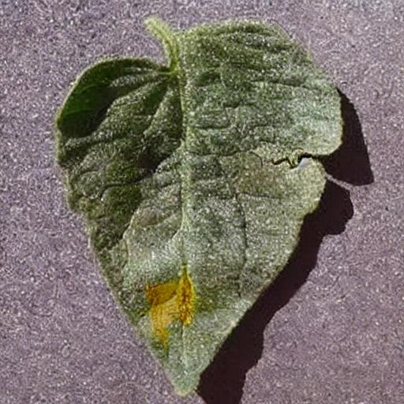
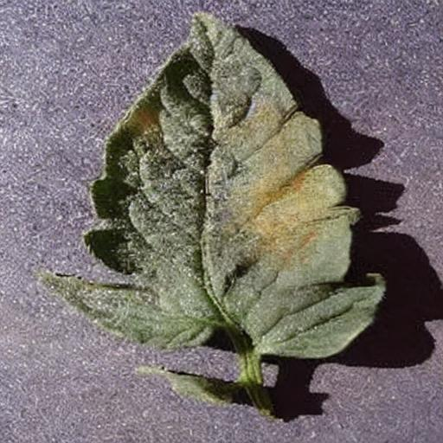
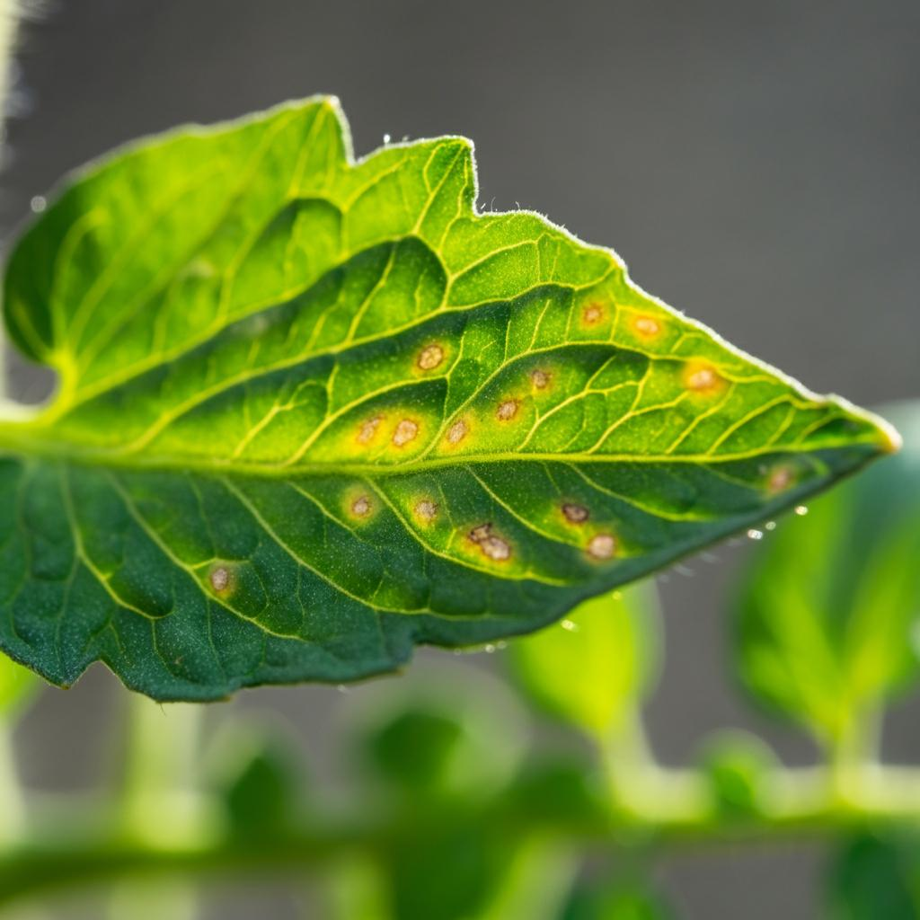
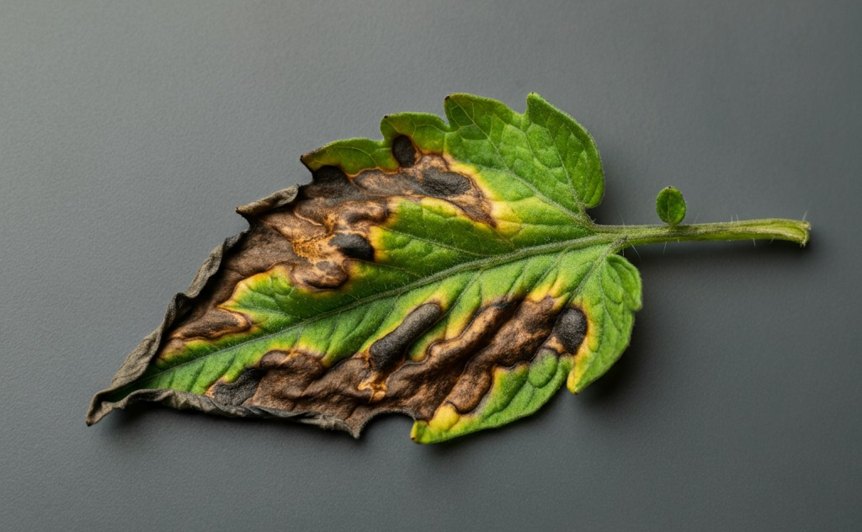
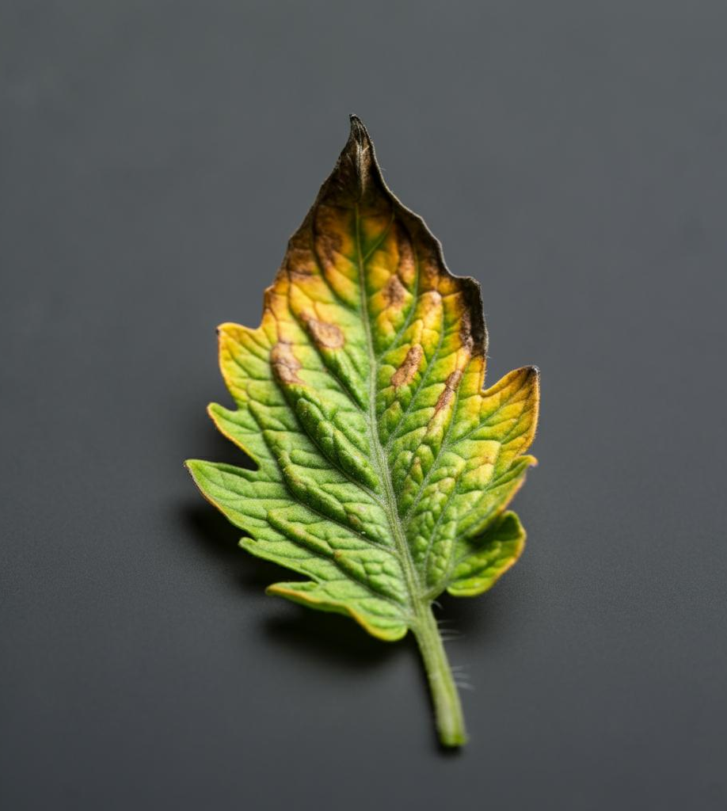
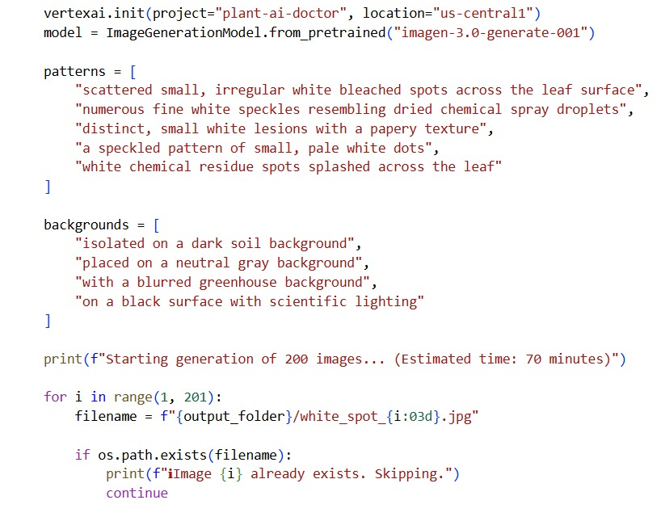
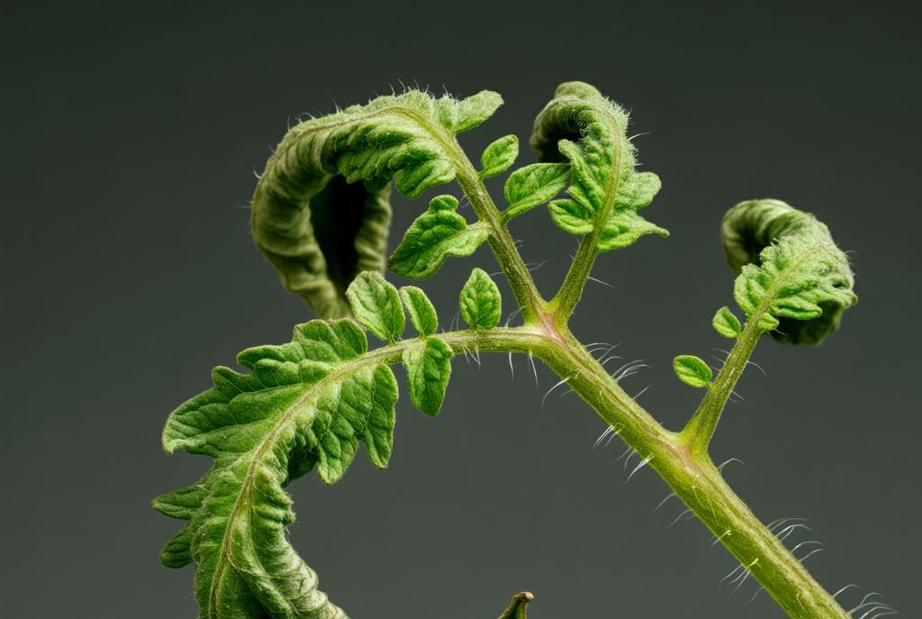
Synthetic Data

Slide 4
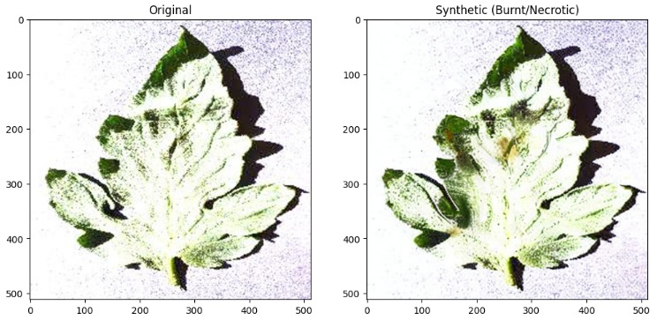
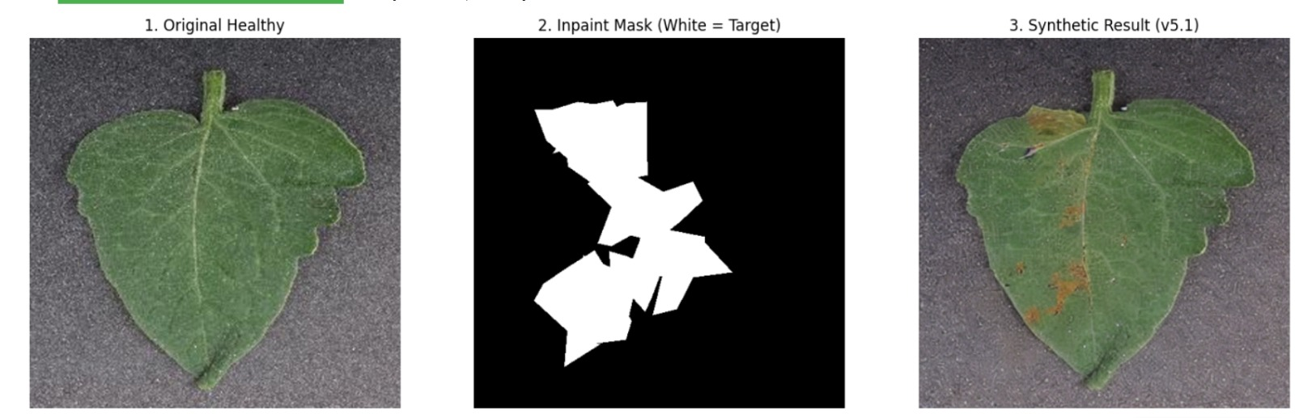
Synthetic Data
Core Engine: Stable Diffusion Generates photorealistic textures and environmental effects based on specific text prompts.
Method: Masked Inpainting Focuses the generation process only on targeted areas, preserving the original background and healthy leaf tissue.
Structural Guidance: ControlNet (Canny) Uses edge detection to maintain the leaf’s original shape and vein structure, ensuring the AI-generated damage stays perfectly within the natural boundaries

Slide 5
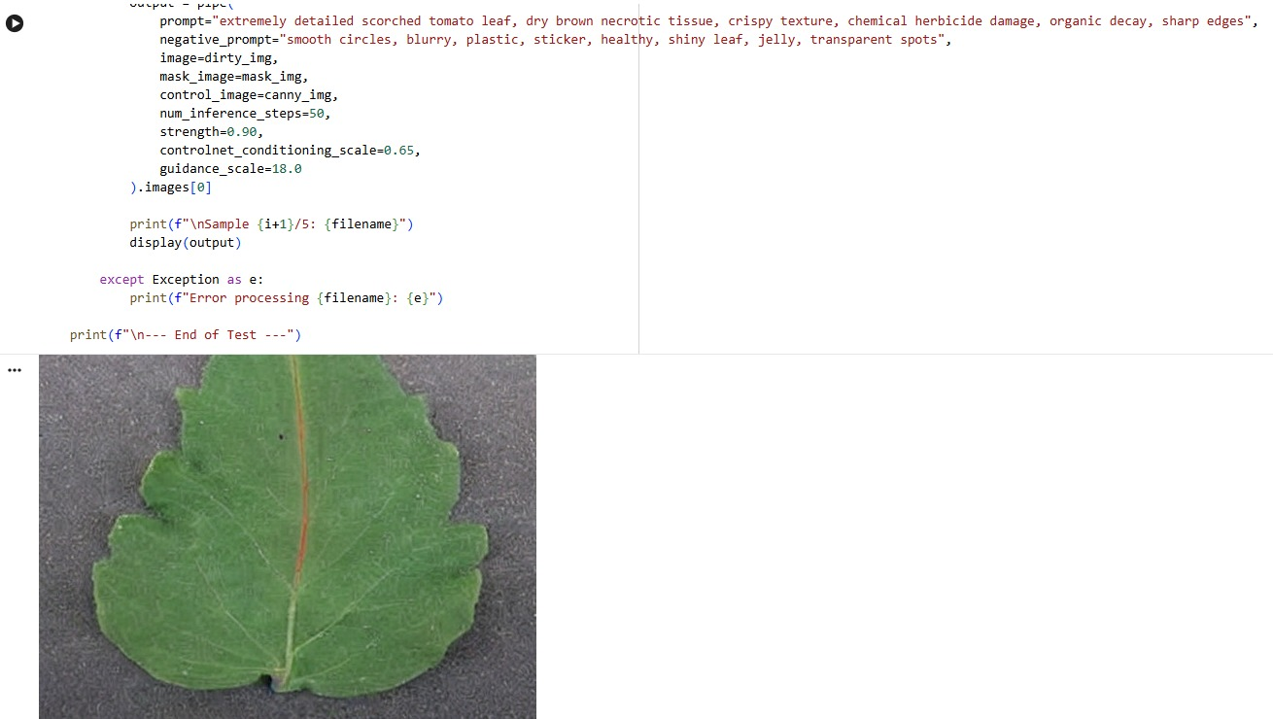
Synthetic Data

Slide 6

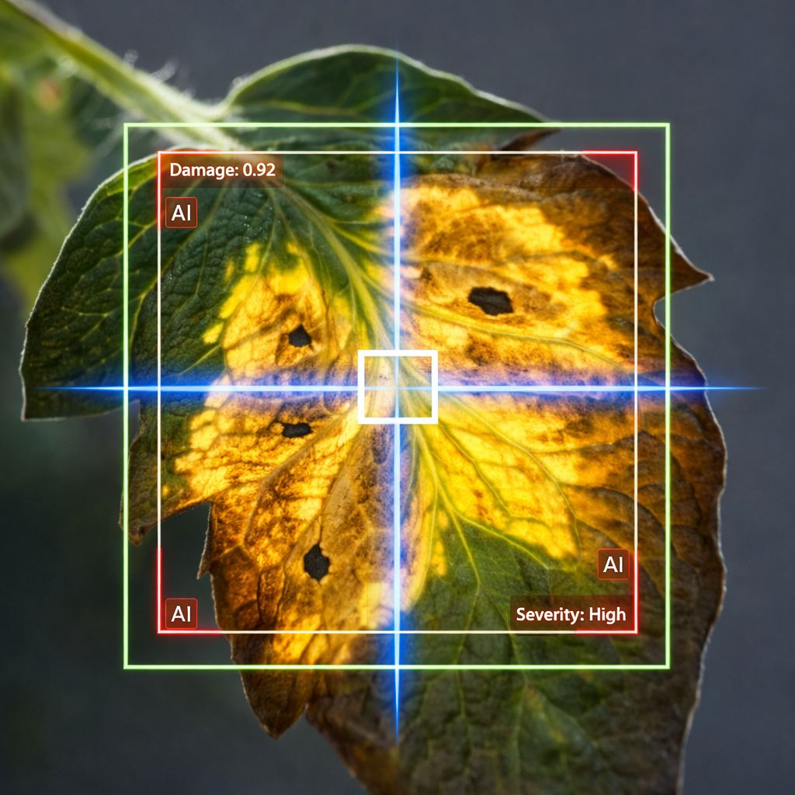
Methodology & Technical Effort
Stress Test (Center Crop)
Data & Model Pipeline
Hybrid Dataset: 690 real biological images vs. 677 high-fidelity synthetic chemical images.
ControlNet: Maintains the structural integrity of leaf veins and anatomical geometry.
Architecture: ResNet18 Transfer Learning optimized for complex texture detection.
Verification: Center Crop was applied to strip away background clues, forcing the model to classify based strictly on leaf pathology textures.

Slide 7

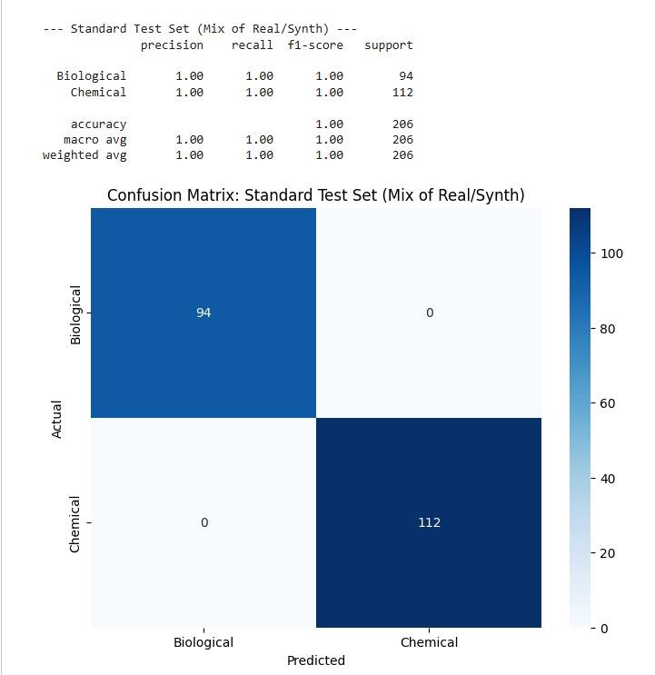
Quantitative Comparison
Performance Metric | Baseline | Plant AI Doctor
Chemical Damage Recall | --- | 86.89%
Biological Specificity | 97.0% | 100.0%
Stress Test Robustness | N/A | 86.89%
Confusion Matrix
The standard model is blind to chemical damage; ours is an expert. *Stress tests conducted using isolated center-crops to prevent background shortcut learning.
Validation: Zero misidentification between categories.

Slide 8




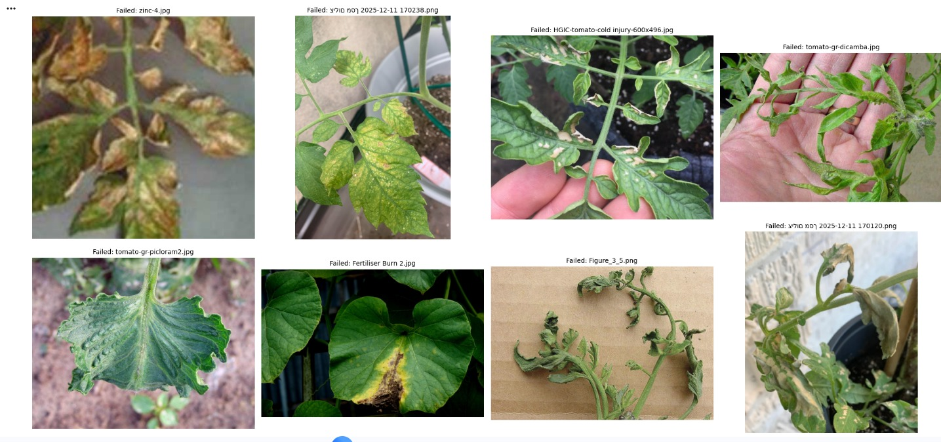
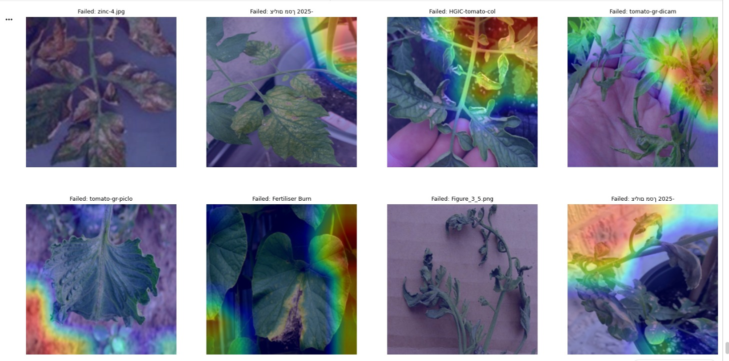

Conclusions & Future Outlook
Interpretability (Grad-CAM)
Challenge: Morphological Distortion
Epinasty Limitations: Most failures occurred in cases with extreme structural leaf distortion (Epinasty), which SD + ControlNet currently struggle to replicate perfectly.
Targeted Focus: Saliency maps confirm the model correctly focuses on burn textures rather than environmental artifacts.
The Verdict
Future Work
Generative AI is an indispensable tool for bridging agricultural data gaps where real-world labeling is logistically impossible.
Expansion to Peppers and Cucumbers; improving structural distortion modeling for full herbicide lifecycle detection.

